Slide 1
Data Spark: Illuminating Insights for Global Electronics

Slide 2
Aim:
Effective Sales Analysis allows a company to allocate Resources more Efficiently.
It helps to Determine which products or services are performing well and which are under-performing.
This insights enables Businesses to focus on promoting High-Performing items and reevaluating or discontinuing under-performers.

Slide 3
Approach:
Data cleaning and Preparation
Load Data using SQL
Power Bi Visualization

Slide 4
Exploratory Data Analysis:
Exploratory data analysis (EDA) is used by data scientists to analyze and investigate data sets and summarize their main characteristics, often employing data visualization methods.

Slide 5
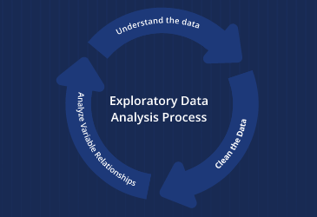

Slide 6
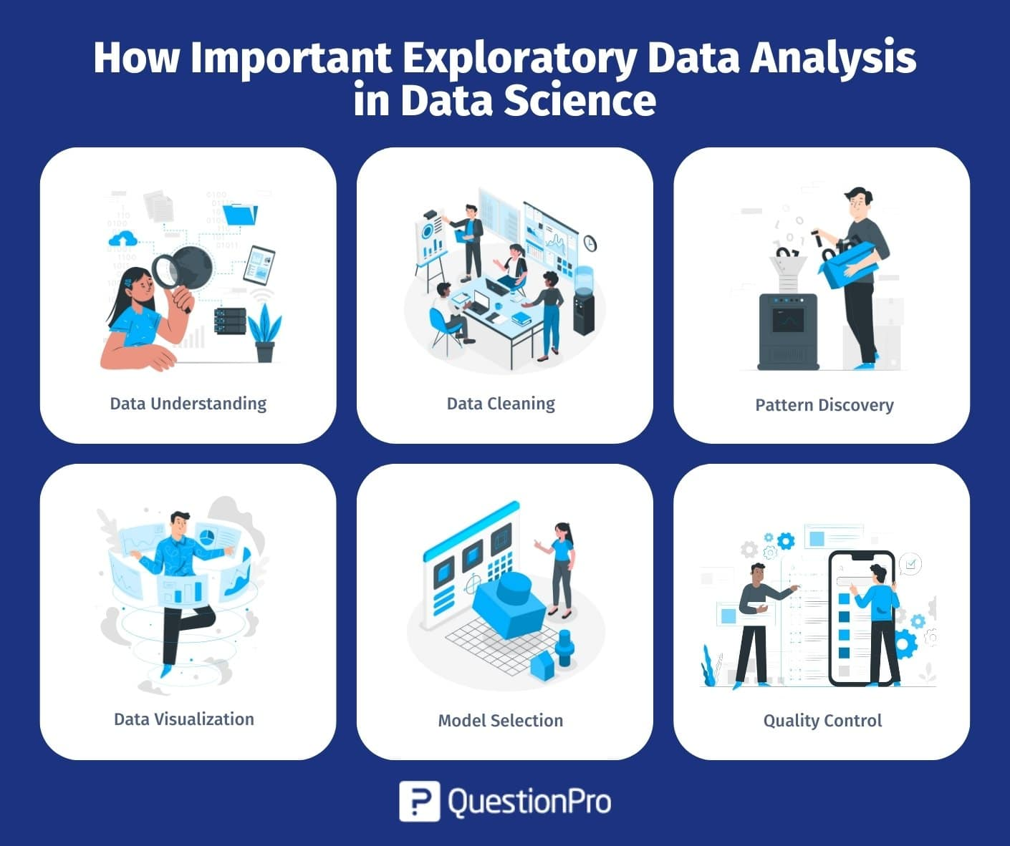

Slide 7
SQL
Structured Query Language
SQL is a programming language for storing and processing information in a relational database.
A relational database stores information in tabular form, with rows and columns representing different data attributes and the various relationships between the data values.

Slide 8

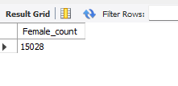


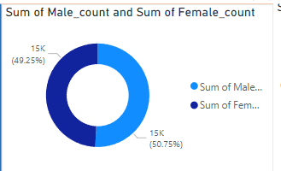
Male and Female Count

Slide 9
Small Difference in male and female counts might indicate that your products or services appeal equally to both genders.
The age group of 60 and above has higher count compare to other age groups, suggesting that older adults are a significant portion of the customer base.
US nearly have 6k-above customers, on other sides Italy, France, Netherlands having fewer than 1000 customers which implies that places need for increased focus.

Slide 10
Power Bi:
Power BI is a business intelligence (BI) platform that provides nontechnical business users with tools for aggregating, analyzing, visualizing and sharing data.
Power BI is used to find insights within an organization's data.
It can help connect disparate data sets, transform and clean the data into a data model and create charts or graphs to provide visuals of the data.
All of this can be shared with other Power BI users within the organization

Slide 11
Advantage of Power Bi
Accessibility
Integrations
Customer support
Customization
Collaboration
Scalability

Slide 12
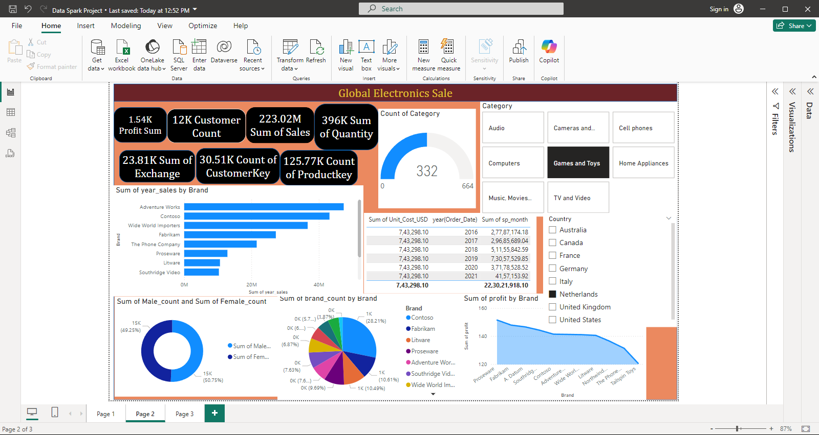

Slide 13
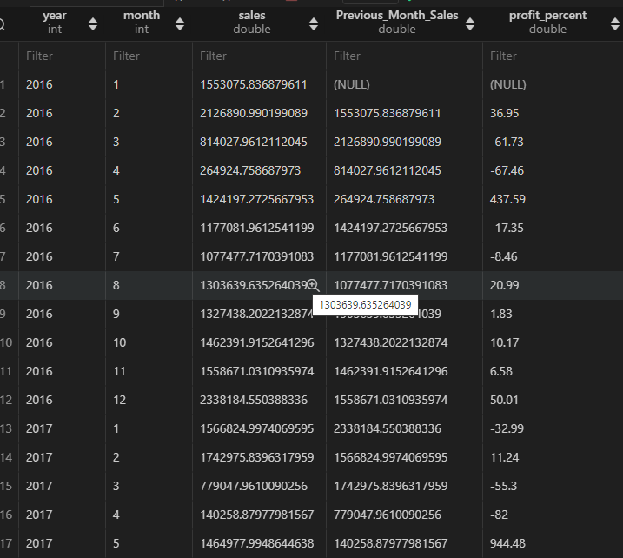
Month wise Profit

Slide 14
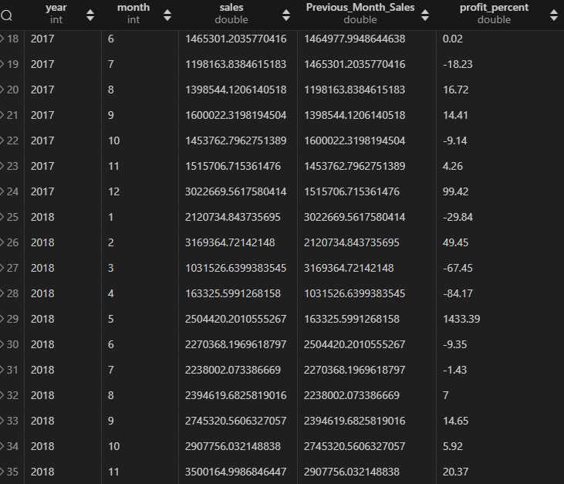

Slide 15
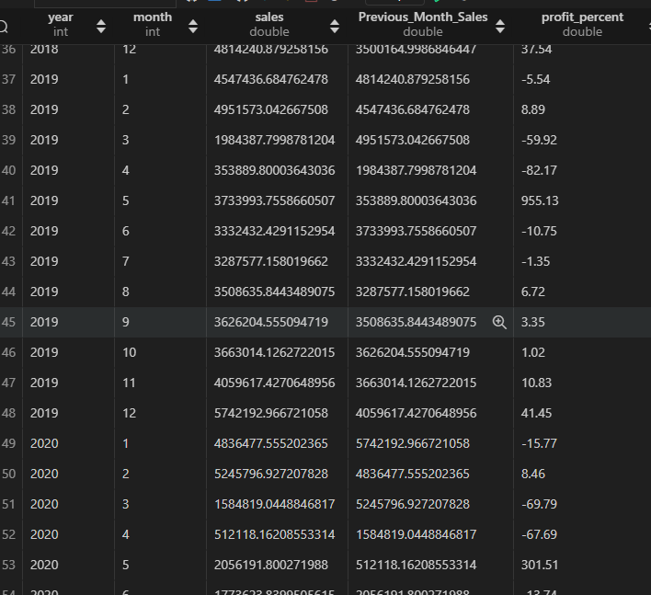

Slide 16
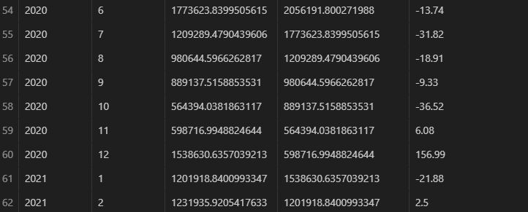

Slide 17
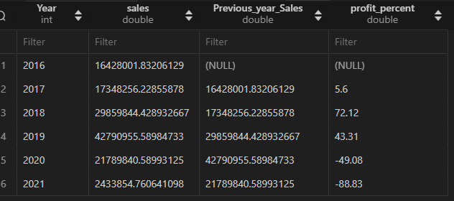
Year wise Profit

Slide 18
Growth and Decline:
The data indicates a period of growth in sales from 2016 to 2019, peaking in 2019.
After that, there is significant decline in 2020 and 2021.

Slide 19
Profit Percentage Fluctuations:
The Profit percentages show large fluctuations.
After a modest increase of 5.6% in 2017, there’s a sharp rise of 72.12% in 2018 followed by a gain of 43.31% in 2019.
Subsequently, there are significant declines of -49.08% in 2020 and -88.83% in 2021.

Slide 20
Enhance Product and Service Offering
Product Innovation
Continuously innovate and improve your products or service based on market trends and customer feedback.
Diversification
Expand your product line to cater to a wider range of customer needs or enter new markets.
Quality Assurance
Ensure high-quality standards for your products or services to build trust and encourage repeat purchases.

Slide 21
Optimize Pricing Strategies
Competitive Pricing
Analyze competitor pricing and adjust your pricing strategy to remain competitive without compromising profitability.
Dynamic Pricing
Implement dynamic pricing models that adjust prices based on demand, customer segments , or market conditions.
Bundling and Discounts
Offer Product Bundles or discounts to incentivize purchases and increase average order value.

